Slide 1


Slide 2
Agenda
About The Company
Problem Statement
Objective
Datasets
Ad Hoc Requests, Solutions and Insights
Conclusions

Slide 3
About the Company
Atliq Hardwares is one of the leading innovators and manufacturers of high-performance computer hardware in India. Established with a vision to power the digital future, Atliq has grown into a trusted brand across domestic and international markets. With a strong presence in over 15 countries, the company caters to a diverse clientele ranging from individual consumers to large enterprises.
Atliq’s product portfolio includes cutting-edge processors, graphic cards, motherboards, storage devices, and other essential computer components that meet the evolving demands of modern technology users.
Backed by a robust R&D With sustainability and customer-centric innovation at its core, Atliq Hardwares is not only redefining performance standards in computer hardware but also playing a key role in shaping the global consumer electronics landscape.

Slide 4
Problem Statement
The management noticed that they do not get enough insights to make quick and smart data-informed decisions.
They want to expand their data analytics team by adding several junior data analysts.
Tony Sharma, their data analytics director wanted to hire someone who is good at both tech and soft skills.
Objective
Answer the 10 Ad hoc business requests provided by the management by running appropriate SQL queries and drive relevant insights the business needs.
Present the findings in a powerpoint presentation which will be presented to the top-level management.

Slide 5
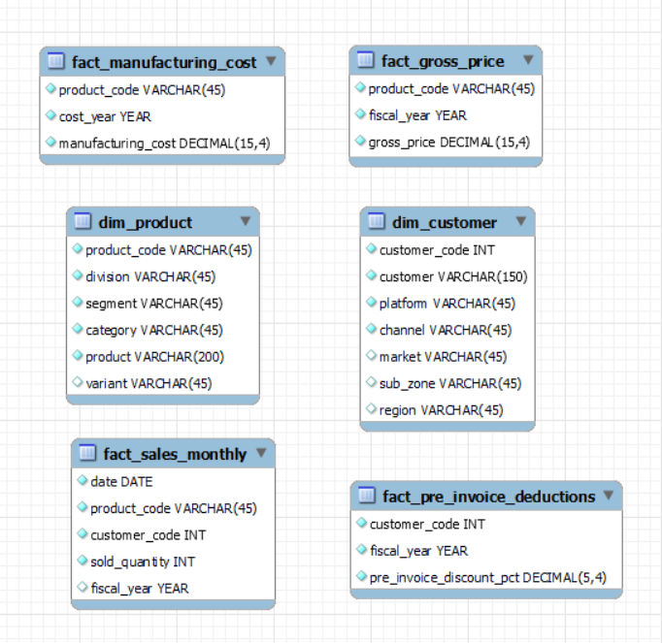
Datasets

Slide 6
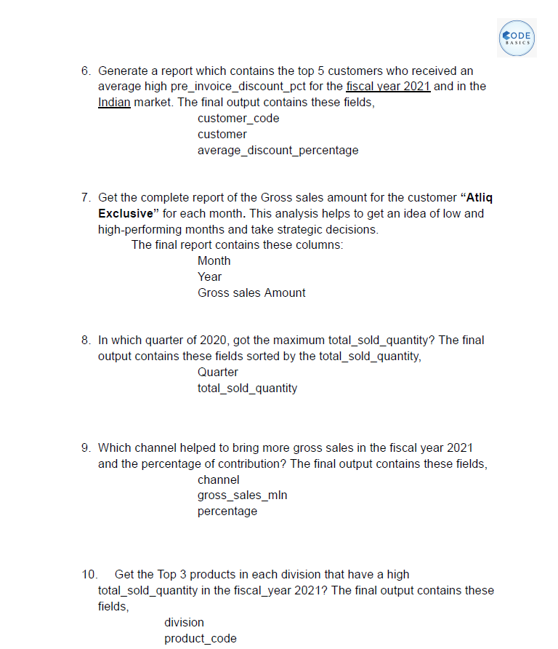
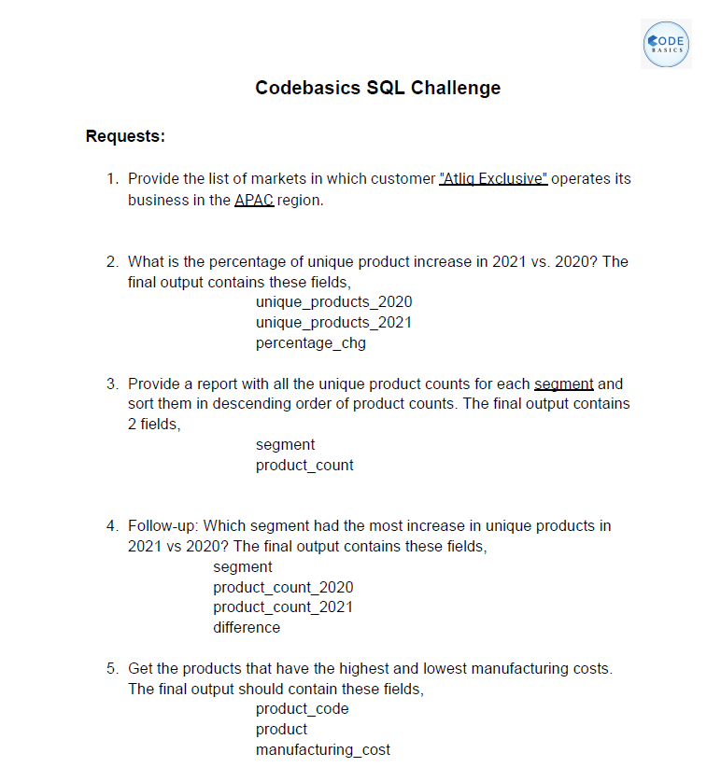

Ad hoc Requests

Slide 7
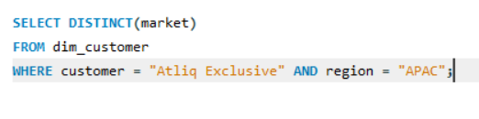
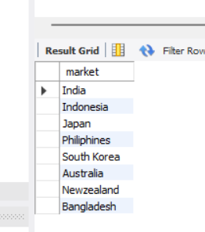
Request 1:
Provide the list of markets in which customer "Atliq Exclusive" operates its business in the APAC region.
SQL Query:
Output:

Slide 8
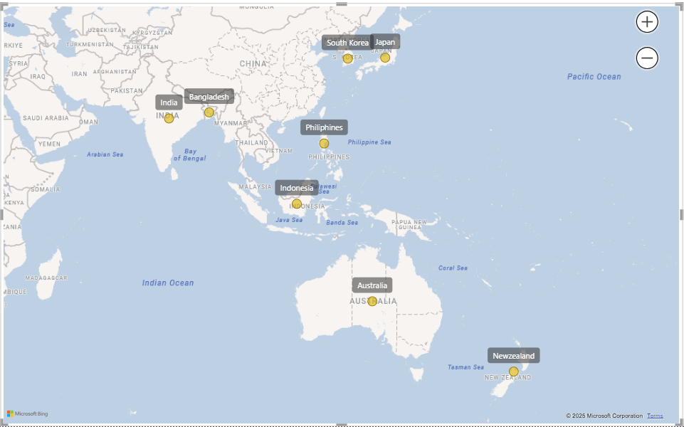
Insight:
Atliq has a good market presence in many Southeast Asian countries but it has no presence in countries like Vietnam and Thailand that have a good reputation in manufacturing sector in the APAC region.

Slide 9
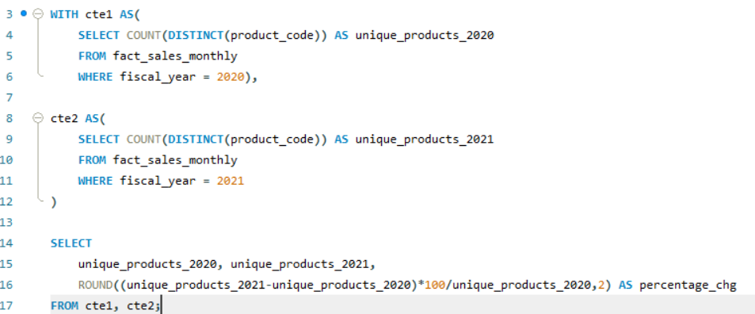
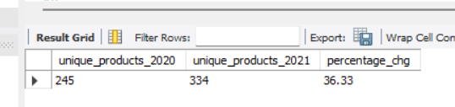
Request 2:
What is the percentage of unique product increase in 2021 vs. 2020? The final output contains these fields, unique_products_2020
unique_products_2021
percentage_chg
SQL Query:
Output:

Slide 10
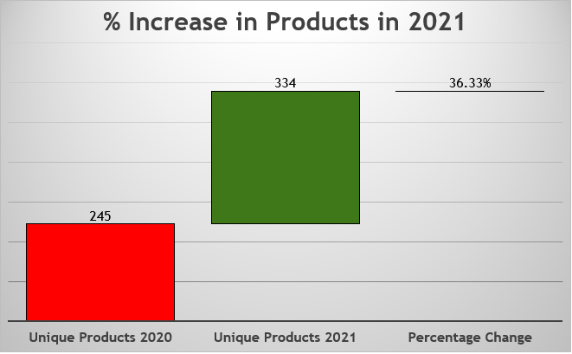
Insight:
The number of unique products increased by 36.33% in 2021 as compared to 2020
Visualization:

Slide 11
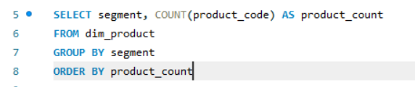
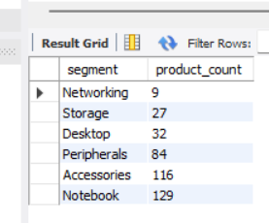
Request 3:
Provide a report with all the unique product counts for each segment and sort them in descending order of product counts. The final output contains 2 fields,
segment
product_count
SQL Query:
Output:

Slide 12
Insight:
The highest number of unique products is in Notebook segment which is 129 and the least number of products is in Networking which is 9.
Visualization:

Slide 13
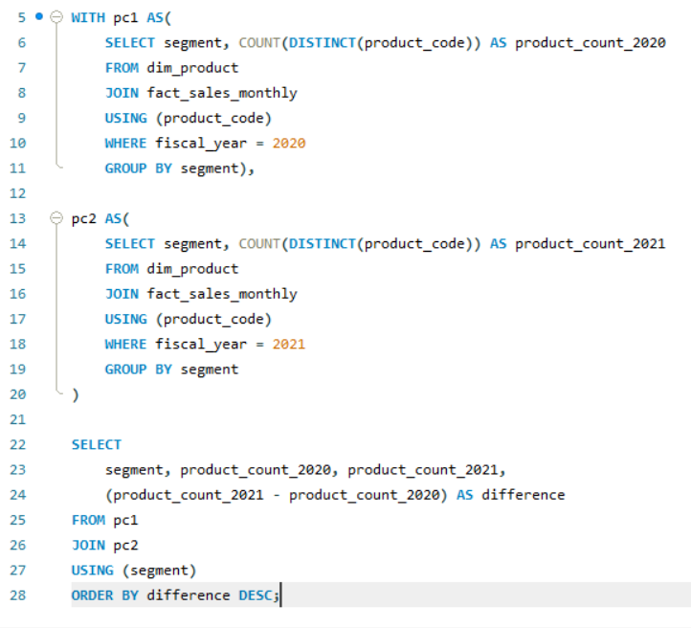
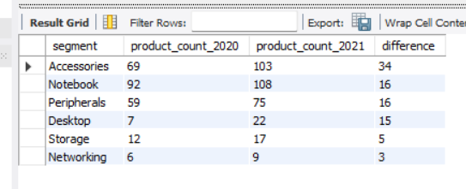
Request 4:
Follow-up: Which segment had the most increase in unique products in 2021 vs 2020? The final output contains these fields,
segment
product_count_2020
product_count_2021
difference
SQL Query:
Output:

Slide 14
Insight:
Although Notebook has more products in Notebook segment but Atliq introduced more number products in Accessories segment and the least in Networking.
Visualization:

Slide 15
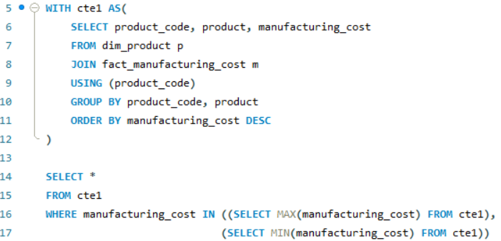
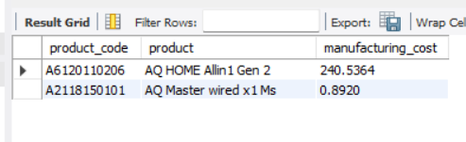
Request 5:
Get the products that have the highest and lowest manufacturing costs. The final output should contain these fields,
product_code
product
manufacturing_cost
SQL Query:
Output:

Slide 16
Insight:
AQ HOME All in 1 Gen 2 incurs highest manufacturing cost among all products.
Visualization:

Slide 17
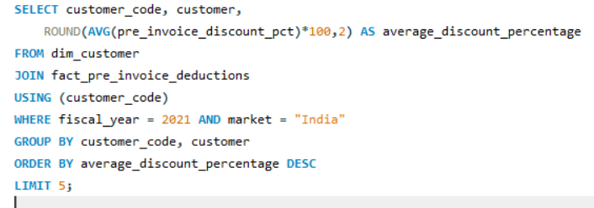
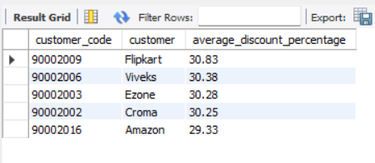
Request 6:
Generate a report which contains the top 5 customers who received an average high pre_invoice_discount_pct for the fiscal year 2021 and in the Indian market. The final output contains these fields,
customer_code
customer
average_discount_percentage
SQL Query:
Output:

Slide 18
Insight:
Flipkart got the highest pre-invoice discount % in 2021 in Indian market among the top five as shown below in the chart.
Visualization:

Slide 19
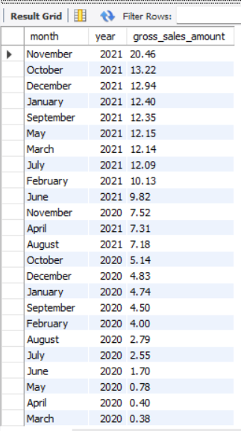
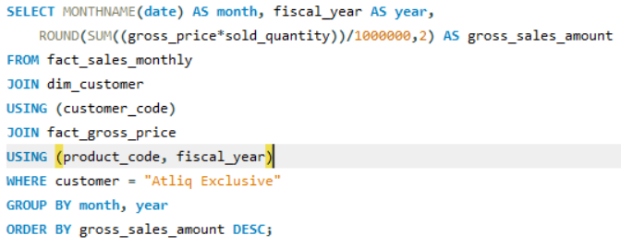
Request 7:
Get the complete report of the Gross sales amount for the customer “Atliq Exclusive” for each month . This analysis helps to get an idea of low and high-performing months and take strategic decisions. The final report contains these columns:
Month
Year
Gross sales Amount
SQL Query:
Output:

Slide 20
Insight:
November (Which is the festive season in countries like India) month generated highest gross sales for Atliq in 2020 and the least in March, the month that got the whole world locked inside their homes and affected many businesses due to Covid-19.
Visualization:

Slide 21
Insight:
November month again generated the highest gross sales for Atliq in 2021 which is 20.46 millions dollars and the least in April which is 7.32 millions dollars.
Visualization:

Slide 22
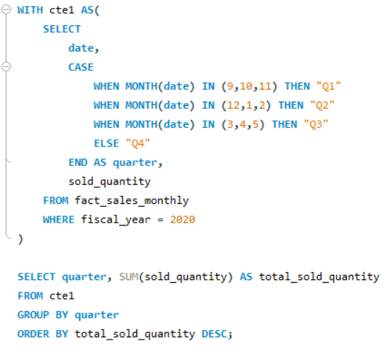
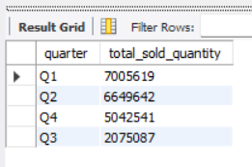
Request 8:
In which quarter of 2020, got the maximum total_sold_quantity? The final output contains these fields sorted by the total_sold_quantity,
Quarter
total_sold_quantity
SQL Query:
Output:

Slide 23
Insight:
Quarter 1 which comprises months like September, October and November generated highest sales for Atliq in 2020 and the least performing quarter was Quarter 3 (March, April, May).
Visualization:

Slide 24
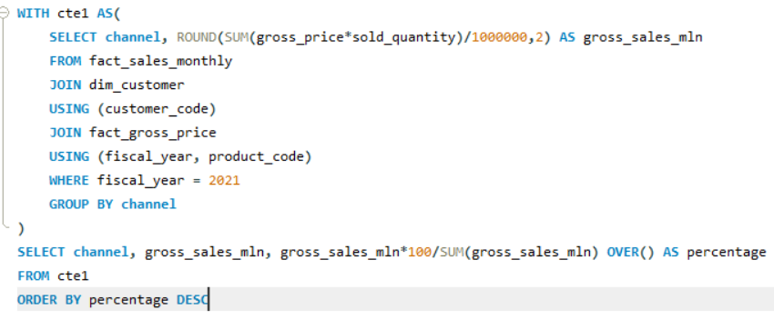
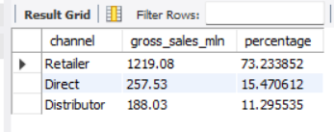
Request 9:
Which channel helped to bring more gross sales in the fiscal year 2021 and the percentage of contribution? The final output contains these fields,
channel
gross_sales_mln
percentage
SQL Query:
Output:

Slide 25
Insight:
AtliQ earned highest gross sales through Retailer channel that contributed around 73.23 % of all the other channels. And the least sales came through Distributor channel that contributed around 11.30 %.
Visualization:

Slide 26
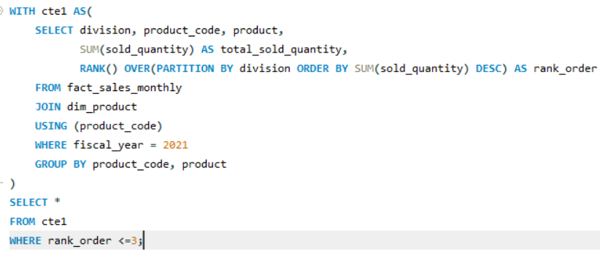
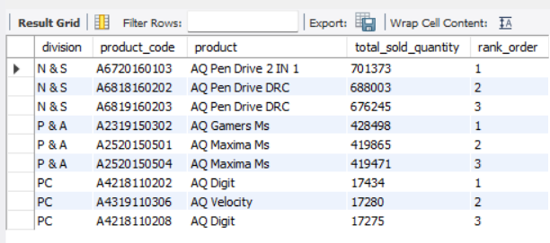
Request 10:
Get the Top 3 products in each division that have a high total_sold_quantity in the fiscal_year 2021? The final output contains these fields,
division, product_code
product, total_sold_quantity
rank_order
SQL Query:
Output:

Slide 28
Conclusions:
Atliq focus more on increasing its number of products in Networking segment.
Atliq should also focus on increasing its sales in Quarter3 which is the least sales generating month for Atliq.
Atliq should also try to expand its markets in Southeast Asian countries like Vietnam and Thailand as these two countries can generate a lot of revenue for Atliq in the manufacturing sector.
Atliq should also focus on marketing its Direct channel i.e., its own stores (Atliq Exclusive and Atliq e Store) as it will help it to get more revenue by providing discounted prices and avoiding costs that are involved in Retail channel like pre-invoice discounts, post-invoice discounts and miscellaneous costs like placement fees.

Slide 29


Thank you
For feedback and suggestions feel free to connect me
with me on:
LinkedIn
Github
Or email me directly at:
ayushrekh12065@gmail.com

